Slide 1
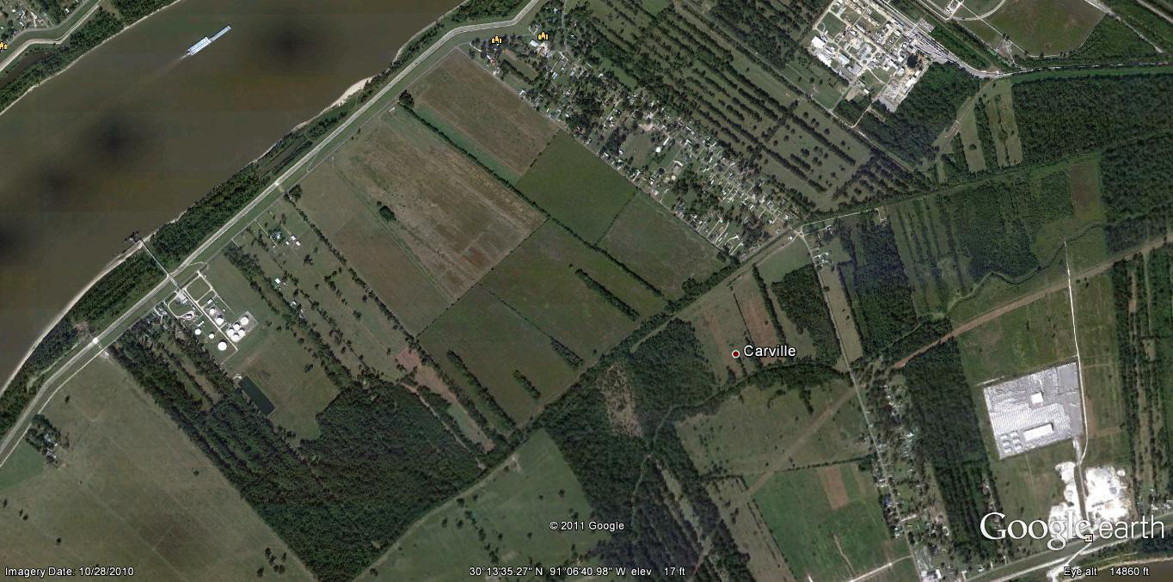
Kinder Morgan St. Gabriel Property Map
Area 1- Approx. 150 acres
- Over 100 acres avail.
Area 2- Approx .115 acres

Slide 2
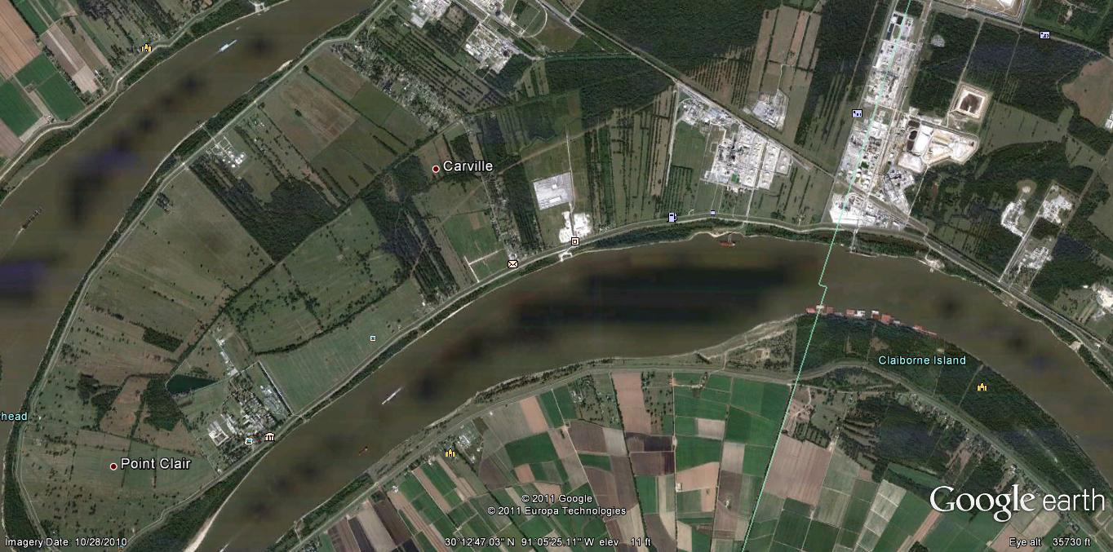
Kinder Morgan St. Gabriel Proximity Map
Kinder Morgan Property
LA National Guard (Carville)

Slide 3
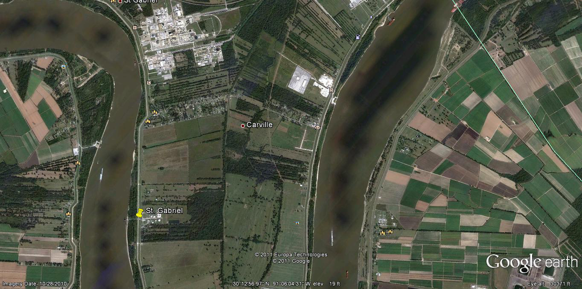
Kinder Morgan St. Gabriel Proximity Map (with servitudes)
Exist. Rail Spur
Rail Servitude
(Approx.)
Exist. Elect. Servitude (Entergy)
Terminal

Slide 4
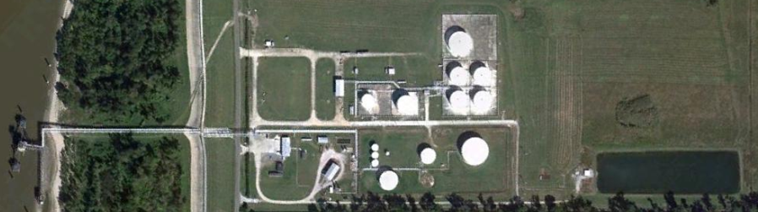
1st Aid Kit
Fire Monitor
Fire Hydrant
Eye Wash and Shower
Fire Extinguisher
Evacuation Route
Rally Point
PPE Free Zone
Wind Sock
Hazardous Waste Satellite
Accumulation Area
Hazardous Waste Storage Area
Spill Kit
Emergency Contacts:
(225) 642-5516 – Main
(225) 264-1451 – TM Cell
(225) 933-9345 – AM Cell
St. Gabriel Terminal Visitor Safety Orientation
PPE FREE ZONES:
CONTROL ROOM PARKING LOT
EVACUATION ROUTES ARE DEPENDANT ON WIND DIRECTION.
SHELTER-IN-PLACE @ CONTROL ROOM
SCALE
460-1
GATE 3
BOILER HOUSE
265-2
260-1
TRUCK RACK
110-1
350-1
265-1
265-3
CONTROL ROOM
DOCK
OIL/WATER SEPARATOR
PARKING LOT
25-1
GATE 2
25-2
5-1
200-1
775-1
25-3
WATER WELL
310-1
FIRE WATER POND
TRUCK LOADING RACK
GATE 1

